Slide 1
What’s your TQ?
Give yourself
1 point
per item
(Technology
Quotient)
Do you / have you…
Use a cell phone regularly
Send TXT messages
Taken a picture with your phone
Used a cell phone to access the Internet
Use IM
Belong to any online groups
Been in an online chat room
Have your own Facebook / MySpace / Bebo page
Participated in online games
Know what twitter is
Bought an item on eBay or Craigslist
Sold one
Watched YouTube video
Authored a YouTube video
Use a GPS
Know what “blogs” are
Read some blogs
Publish (at least) one blog
Cleaned up from a virus or spyware attack
Had a conversation with kids about how to stay safe online

Slide 2
Students in Today’s High-Tech World … and What’s Our Role?
John Richardson – Privacy & Security Expert (& Parent)
January 21, 2009

Slide 3
Goals
Provide awareness of technology and its impact on students
Provide parents with an answer to the question “what can we do about it?”

Slide 4
Agenda
Introduction
Technology uses and risks for students
Technology world of our kids, social networking, cyber safety, cheating
What can parents do about it?
Set clear policies, teach perspective, take a cyberspace walk together
Technology pros & cons in research
Where do they get information, plagiarism, information quality

Slide 5
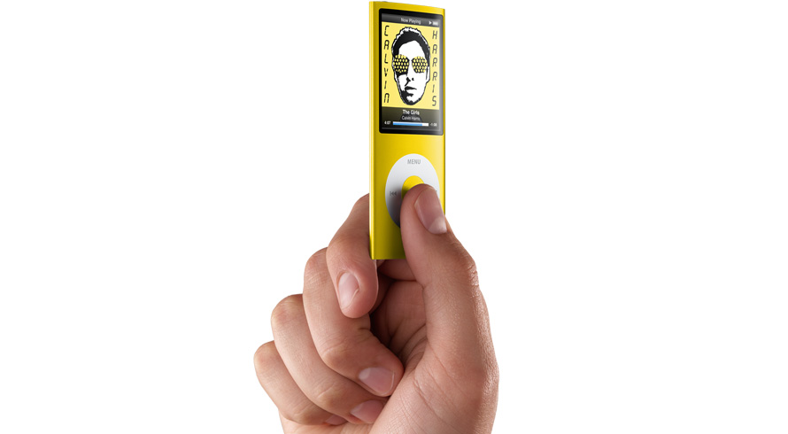
High-Technology and the Student
Basic cell phones
Text messaging, cameras, address book
Smart phones
Run programs, internet access, location
iPods and other music players
Programmable calculators
Home computers
Communication sites
IM, Chat, AIM, Skype, iChat,
Free email accounts (gmail, msn, yahoo, myway, aol)
Social networking
MySpace, Facebook, Blogging (blogspot), Youtube
Games
Webkinz, World of Warcraft, Sims
Portals & Search
Google, Yahoo
Information
Homework sites, Wikipedia
E-commerce
E-bay, Craigslist
Bittorent, file sharing services
Technology
Online World
Notes:
Over 2 TRILLION SMS messages last year

Slide 6
What’s Different Today?
Today’s students are multimedia publishers
The create personal spaces with MySpace & Facebook
They can write blogs
They can take digital pictures all the time
And publish them with Picassa or their space
They can easily create movies
And publish them with YouTube
They are connected more of the time – text messaging, IM, twitter

Slide 7
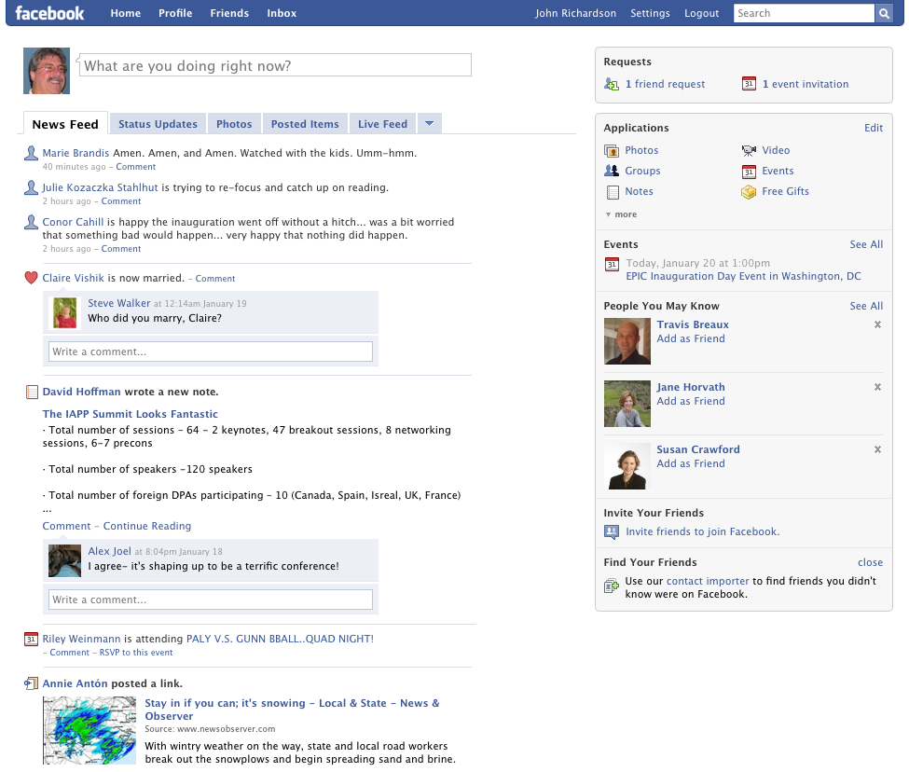
Notes:
Name, date of birth, age, state,
Depression, lack of positive self-image, self-esteem..

Slide 8
Video – The Lure of social networking
Notes:
Video is 7:07
http://www.youtube.com/watch?v=g6YT6sEDZiE

Slide 9
Key Risks for Kids
Cyber stalking
Kid’s assume what they see online is true – including claims that a buddy is their age
Cyber bullying & slam sites
Cheating
Plagiarism
Cell phone camera
Too much screen time
What's true & what's not - checking authenticity

Slide 10
Video – If you wouldn’t say it in person, don’t say it online
Notes:
http://www.youtube.com/watch?v=seOQyMvG99w&feature=user
Video is 50 seconds long

Slide 11
Why is Cyber bullying so Prevalent?
Kids technology skills have far surpassed their parents’ skills
There is very little monitoring in cyberspace
Technology doesn’t provide tangible feedback
“I’m invisible, you’re invisible” (Nancy Willard)
My psuedononymous account protects me from the consequences of my actions
I can’t see your reaction to what I have written or posted.
Notes:
No empathy since you can’t see their face, you hide behind screen name
I had typing in middle school aaa space say it to yourself space, ,now ultra keyboarding program my first grader does
Average family has how many computers- we had none in our homes growing up (I’m dating myself - 41)

Slide 12
Cheating
All the old ways still work, but…
Technology offers new ways to hide data
Simple hybrids
Paper inside battery compartment
Using technology as designed
On the internet during class
Stored notes on phone, iPod, calculator
TXT messaging for help
TXT messages to the next class about the test
Videos on YouTube offer help with cheating…

Slide 13
Notes:
Video is 1:37. Made from videos from YouTube –
http://www.youtube.com/watch?v=r9uCFuC0gHo&feature=related – how to cheat on a test final, and
http://www.youtube.com/watch?v=91lQK5SCzlQ&feature=related – how to cheat on any test

Slide 14
What Can Parents Do?
Discuss Technology Use Ahead of Time
Have Clear Technology Use Policies
Take a Walk Through Cyberspace with your Child

Slide 15
How Parents Help Keep Kids Safe
Educate yourself about digital technologies!
Use prudence in your own online behaviors (including blogging)
Exercise basic responsible computing
Set clear expectations – and follow through

Slide 16
Discuss Ahead of Time
Discuss your family values and how they apply
Great tool – empathy – how would you feel if…
Support system
Keep lines of communication open
Trust but verify
Who do they turn to if something happens?
How will you support them?
What do Kids Need to Know?
What information not to share / how to not share it
What can happen to them
What do you do when you find something that makes you uncomfortable?
Kids going to inappropriate sites
Kids interacting with people you don't know or don't approve of
Kids arranging to meet somebody they met in cyberspace

Slide 17
Teach Your Kids Effective Decision Making Strategies
The “Golden Rule” test
How would you feel if someone did the same thing to you?
The “Mom or Dad” test
What would your Mom or Dad think?
The “Front Page” test
If your actions were reported on the front page of a newspaper what would other people think?
The “If Everybody Did It” test
What would happen if everybody made the decision to do this?
The “Check Inside” test
How do you feel inside?
Source: What is Right and What is Wrong? By Nancy Willard http://netizen.uoregon.edu

Slide 18
Technology Policy Suggestions
Online ONLY in communal spaces
No connected computers, including laptops using wireless, in bedrooms
All computer use may be monitored
Limit screen time (quantity and time-of-day)
For ALL types of screens – TV, computer, IM, cell phone, games, iPod
Have rules for what must be completed before screen time
Devices downstairs at bedtime – nothing in their room
Allow Internet access only when parents are home
Only communicate (e-mail, IM, TXT) with people you already know (in real life)
Parents have a list of all accounts you use and all passwords
Discuss list of sites they are allowed to visit

Slide 19
Take A Walk Through Cyberspace – With Your Child
Pull up a chair next to your child at the computer and ask them to…
Share with me all the programs and sites you use for gaming, IM and social networking sites
Share with me all the screen names and email accounts you use and passwords (example)
Show me your personal website, and any profiles you have on social networking sites, as well as your “away” message
Share with me your buddy list – ensure you know IRL*
Ask if they’ve shared their password with a friend
Define cyber-bullying and discuss (& show video)
Check for naivety, “the digital wake”, sharing information, reputation, and “netiquette”
Create a safe respectable online personality
Establish trust-but-verify policy
Consider appropriate technology for their age
Adapted from http://www.ryanpatrickhalligan.org/cyberbullying.htm
*IRL = In Real Life

Slide 20
7 Rules for Social Networking Parents
Don’t Assume You Know
Don’t Assume They Don’t Know
They’re Smarter Than You
They Won’t Always Tell the Truth
Move the PC to a Central Location
Install Parental Control Software
Be Yourself
Notes:
From a PC Magazine article at: http://www.pcmag.com/article2/0,2817,2321587,00.asp
Don't Assume You Know: I regularly talk to parents who believe that their children aren't online when they're not around. Typically, they're wrong. One of the best ways to find out what your kid is doing online is to talk to the parents of your kid's best friend. You'll likely discover that, say, your daughter is not only on MySpace but has multiple profiles. It's not uncommon for teens to create one profile that reflects more or less who they really are and another that's a more extreme version of themselves.
Don't Assume They Don't Know: If you haven't visited MySpace, Facebook, Bebo, Friendster, or any other social-networking site and you never talk about them with your kids, do not assume that your child is unaware of their existence. Young children, who are typically more open about their online desires ("Please, Mommy, can I go on Club Penguin?") are maturing into teens with social-networking hardwired into their psyches. They already know exactly where to go and what to do.
They're Smarter than You: While you're still struggling to figure out how to transfer your photos from your digital camera to your PC, your teenage sons and daughters are doing some expert Photoshop work to make themselves look just a bit tougher, cooler, sexier than they do in person. And they're posting these images on their MySpace pages (one 14-year-old girl I read about was posting lingerie shots—and her parents had no idea). More likely, however, they know how to copy and paste photos from other sites into their own profiles. Do you know how to do this? Probably not.
They Won't Always Tell the Truth: When you're sitting at the dinner table discussing the tragedy of the MySpace teen who committed suicide, or the local kid that got caught posting illegal songs, or the kid that was using his profile to taunt and intimidate other kids in school, don't expect Junior to talk openly about his online activities. In fact, if you ask him about it, he may simply tell you he doesn't have a profile.
Discouraging, I know, but these are the harsh realities of our online generation gap. You can do a few things to improve the situation:
Move the PC to a Central Location: I say this all the time, though I know that most parents let their teens have PCs and Internet connections in their bedrooms and then let them close the door and spend hours online alone. This is a mistake. Teens under 18 should not be online away from the watchful eyes of their parents. You don't have to stand over your kid's shoulder. Just having you in the vicinity will discourage a world of shenanigans.
Install Parental-Control Software: We've reviewed some pretty intense apps here at PCMag.com. Safe Eyes and Net Nanny both do an excellent job of controlling Internet access and reporting on social-networking activities. They'll even tell you when someone on your network has shared personal information (full name, address, and so on). If you do use this stuff, however, please tell your kids in advance. A big part of the success of any of these tactics is trust. Your children will likely argue that "trusting" them means you should let them go online alone and without parental interference. Explain to them that you do trust them, and that it's everyone else out there who may not be as trustworthy. Tell them that you would no sooner let them go online without protection than you would allow them to walk alone at night in the worst part of town.
Be Yourself: If you want to get involved with your teen's online activities, go ahead and create your own MySpace, Facebook, Bebo, YouTube, and even Twitter accounts. Set a good example, and don't lie about who you are online. Being out there, involved, and aware of what's going on in these environments will make it much easier for you to engage with your always-online teen.
Judging by conversations I've been having, most seemingly intelligent parents are not doing any of these things. The less-intelligent ones—those who, say, drive around without their seatbelts on—are locks for not knowing the first thing about protecting their kids and themselves online.
The Internet is a wonderful tool, but in some situations it seems to magnify our frailties. We have to harden ourselves a bit if we want our children to enjoy the fruits of online access without everything else turning rotten.

Slide 21
Research
Information Sources
Quality of Information
Dealing with Plagiarism

Slide 22
Research
Quiz: What’s the first place kids turn to?
Google
Is Wikipedia unreliable?
Constant review & updates differentiate it from print media
Jimmy Wales' Wikipedia comes close to Britannica in terms of the accuracy of its science entries, a Nature investigation finds. – Nature, December 2005, updated March 2006

Slide 23
Quality of Sources Online
Use and teach techniques for critical examination
Lots of good material on this
For example, aspects of web evaluation included
Authorship , Perspectives, Publishing Body/Publisher, Coverage, Currency, Accuracy or Verifiability
I started here:
http://new.vawnet.org/category/index_pages.php?category_id=761

Slide 24
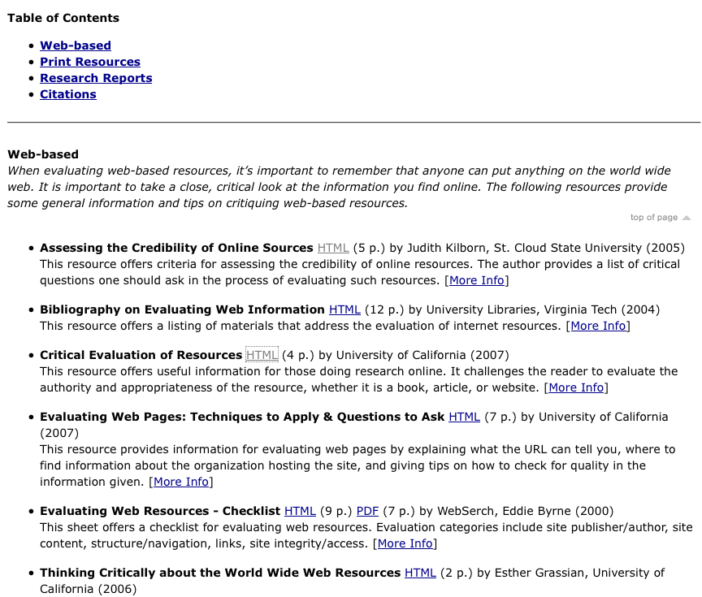

Slide 25
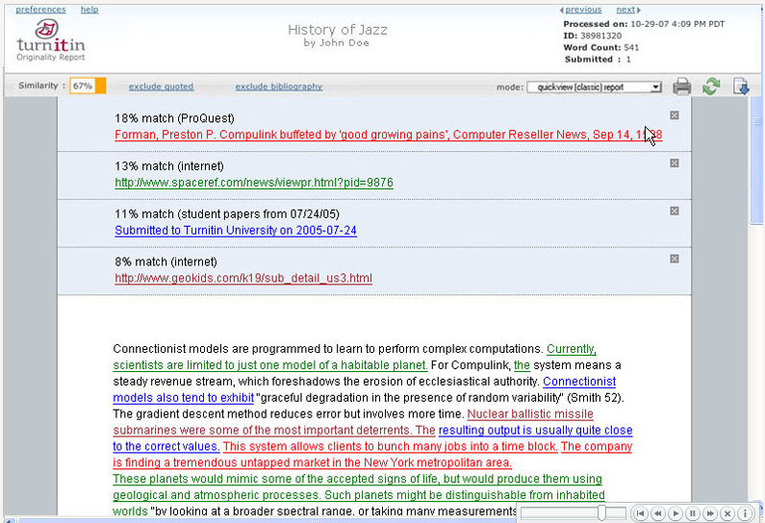

Slide 26
How might we guide researchers?
Effective use of searching techniques
Specific keywords
Mandatory marker ‘+’
Advanced features like eliminating undesired overlaps
Critical thinking / skeptical eye
Using (and keeping track of) multiple sources
Evaluating quality of sources
Proper citations
Clear coverage of plagiarism
Including appropriate policies

Slide 27
Resources for Parents
This Presentation is Available at:
http://web.mac.com/jwr_pdx/Site/Cyber_Safety.html
Contact Information
John Richardson
Security and Privacy Consultant
Lumination, LLC
jr@LuminationLLC.com

Slide 28
Technology Policy Suggestions
Online ONLY in communal spaces
No connected computers, including laptops using wireless, in bedrooms
All computer use may be monitored
Limit screen time (quantity and time-of-day)
For ALL types of screens – TV, computer, IM, cell phone, games, iPod
Have rules for what must be completed before screen time
Devices downstairs at bedtime – nothing in their room
Allow Internet access only when parents are home
Only communicate (e-mail, IM, TXT) with people you already know (in real life)
Parents have a list of all accounts you use and all passwords
Discuss list of sites they are allowed to visit

Slide 29
Screen Time Checklist Suggestions
Before Screen Time…
Today’s homework is finished
Your homework & notebook is in your backpack
Your space at the table is cleaned up
You have completed today’s household chores
You are on schedule with any project you have (if no schedule, make one)
Instrument practice is complete
Your lunch box is by the sink (any trash thrown out)
Your coat is hung up
Your bed is made and clothes picked up
It is BEFORE 8:00 on school nights (8:30 on non-school nights)

Slide 30
Resources
www.NetSmartz.org, www.NetSmartzKids.org -- Resources for educators, parents, kids on how to stay safe online. Excellent presentations, videos, games, and more.
www.netlingo.com -- Large list of net acronyms, including the top 50 parents should know
www.cybertipline.com -- Run by the National Center for Missing and Exploited Children
Parents can report online abuse -- good resources.
www.SafeKids.com -- Cyber safety tips, stories, and news
www.SafetyEd.org -- General safety stuff, including car, bike, and computer
www.GetNetWise.org -- General internet safety for parents & kids
www.stopcyberbullying.org - For parents and kids on cyberbullying
www.ryanpatrickhalligan.org/cyberbullying.htm -- Father of student who committed suicide after being cyber-bullied
www.speedofcreativity.org/resources/videos-for-pd/ -- Lots of video examples to watch by yourself or with your child
www.media-awareness.ca -- Good resources, including checklists
www.plagiarism.org -- Definitions, discussion, resources on plagiarism
MySpace Unraveled, Larry Magid and Anne Clooier, ISBN 0-321-48018-X
Generation MySpace, Candice Kelsey
Internet & Computer Ethics for Kids, Winn Schwartau, ISBN 0-9628700-5-6

Slide 31
Top 50 Concerning Internet Acronyms Parents Need to Know:
1. 8 - it refers to oral sex
2. 1337 - it means elite
3. 143 - it means I love you
4. 182 - it means I hate you
5. 459 - it also means I love you
6. 1174 - it means nude club
7. 420 - it refers to marijuana
8. ADR or addy - Address
9. ASL - Age/Sex/Location
10. banana - it means penis
11. CD9 - it means Code 9 = parents are around
12. DUM - Do You Masturbate?
13. DUSL - Do You Scream Loud?
14. FB - F*** Buddy
15. FMLTWIA - F*** Me Like The Whore I Am
16. FOL - Fond Of Leather
17. GNOC - Get Naked On Cam (webcam)
18. GYPO - Get Your Pants Off
19. IAYM - I Am Your Master
20. IF/IB - In the Front or In the Back
21. IIT - Is It Tight?
22. ILF/MD - I Love Female/Male Dominance
23. IMEZRU - I Am Easy, Are You?
24. IWSN - I Want Sex Now
25. J/O - Jerking Off
26. KFY - Kiss For You
27. kitty - it means vagina
28. KPC - Keeping Parents Clueless
29. LMIRL - Let's Meet In Real Life
30. MOOS - Member(s) Of the Opposite Sex
31. MOSS or MOTSS - Member(s) Of The Same Sex
32. MorF - Male or Female
33. MOS - Mom Over Shoulder
34. MPFB - My Personal F*** Buddy
35. NALOPKT - Not A Lot Of People Know That
36. NIFOC - Nude In Front Of Computer
37. NMU - Not Much, You?
38. P911 - Parent Alert
39. PAL - Parents Are Listening
40. PAW - Parents Are Watching
41. PIR - Parent In Room
42. POS - Parent Over Shoulder
43. PRON – Porn
44. Q2C - Quick To Cum
45. RU/18 - Are You Over 18?
46. RUH - Are You Horny?
47. S2R - Send To Recieve (pictures)
48. SorG - Straight or Gay
49. TDTM - Talk Dirty To Me
50. WYCM - Will You Call Me?
For Mature Audiences

Slide 32
Responsible Computing
Tools & Maintenance
Anti-virus
Firewall
Up-to-date software
Operating system, Java, Adobe, Office tools
Subscriptions
Tiered email accounts
Netiquette
Don't send a message when you're angry -- write but don't send if you must.
Don't forward nasty messages
Only forward with permission
Address list minimization
Don't fall into group mentality about nasty online sites
Reply-all

Slide 33
Suggestions for Responsible Use of a Windows System
Do regular backups
Use USB disks, writable DVDs, thumb drives, online, and/or other computers in your house – photos especially
Anti-virus (MOST IMPORTANT)
Have a subscription to get regular updates
Have auto-update turned on
Do weekly full-system scans (3AM is a good time)
Firewall
Use Windows firewall (enable in control panel) – or the firewall from your AV
Microsoft Update
Does all Windows update does, but includes MS Office
Set to automatically update the system
Run it manually every month or so and select “Custom” and get non-critical updates
Anti-spyware, phishing, etc.
Most AV tools have all these features – spyware is important, phishing, spam, their backup less so
Consider using “Spybot search and destroy” periodically (www.safer-networking.org)
Keep other software up to date
Adobe Reader, Flash, and Shockware (www.adobe.com)
Java (sun.com)
Clean out your temp files and defragment your disk every 6 months
Consider parental control software
You are looking to keep logs, limit sites, set time limits (quantity and time-of-day)
Source: John Richardson, on the shoulders of many others

Slide 34
What to do when…
Somebody stumbles on inappropriate material
Get out of it (if possible)
Tell your parents / advisor
Check for virus
You feel uncomfortable
Get offline
Tell your parents / advisor
Make sure you’ve followed safe computing
Parents – save session info…
You get a virus / spyware
Reboot – some are just memory resident
Run anti-virus / anti-spyware scan
If it doesn’t go away, get help!
Source: John Richardson, on the shoulders of many others

Slide 35
Considering Time and Balance
How it is
The average child is watching about 3 hours of TV per day¹
The average kid spends 5½ hours on all media combined²
An estimated 17 percent of kids 2-19 years are overweight³
Recommendations
Screen time should be limited to no more than 1 to 2 hours of quality programming a day for children 2 years and older.¹
School-age children should have a minimum of one hour of physical activity per day⁴
School-age children should not be inactive for periods longer than 2 hours⁴
Sources: ¹ American Academy of Pediatrics
² Kaiser Family Foundation
³ 2003-2004 National Health and Nutrition Examination Survey (NHANES)
⁴ National Association for Sport and Physical Education (NASPE)

Slide 36
Choosing Good Passwords
Don't Use:
Your name - any part of it (first, last, middle, or intials)
Your social security number
Names of friends, family, or pets
Birthdates
Phone numbers or addresses
Any other personal information that could be guessed
Place names
Words from the English dictionary
Words from a foreign dictionary
Your username or login name
Your computer's name
Repetition of the same letter
Sequences of keyboard keys, such as "12345" or "qwerty", or sequences of letters such as "abcde"
Any minor variation of the above, such as spelling your name backwards or appending a character to the end of your name
Do Use:
Six or more characters
A mix of upper and lower-case letters (placing capital letters in random locations throughout a password is also highly effective)
A password you can type quickly, without having to look at the keyboard. This will make it harder for someone to steal your password by looking over your shoulder.
Nonsense words that are easy to pronounce (and to remember, so you don't have to write them down) but aren't listed in any dictionaries
Note: A good way to choose a secure, but easy-to-remember password is to use the first character of each word in a phrase, poem, or song lyric. For instance, "Asb*Mf" stands for "April showers bring May flowers"; the asterisk in the middle is included for extra security. (But don't use this password now that it's been given as an example!)

Slide 37
Social Network Eligibility
See good list on Wikipedia (of 135!)
http://en.wikipedia.org/wiki/List_of_social_networking_websites
Key Sites
Facebook – 13 and older (13-18 in school)
MySpace – 14 and older
Second Life – 13-18 separate space, 18-
Friendster – 16 and older
Bebo – 13 and older
Notes:
Facebook: Eligibility
Membership in the Service is void where prohibited. This Site is intended solely for users who are thirteen (13) years of age or older, and users of the Site under 18 who are currently in high school or college. Any registration by, use of or access to the Site by anyone under 13, or by anyone who is under 18 and not in high school or college, is unauthorized, unlicensed and in violation of these Terms of Use. By using the Service or the Site, you represent and warrant that you are 13 or older and in high school or college, or else that you are 18 or older, and that you agree to and to abide by all of the terms and conditions of this Agreement.

Slide 38
Notes:
Lee LeFever – 2:25 - http://www.commoncraft.com/Twitter

