Slide 1
How Far Gone Are You?
1 point
per item that applies to you
Your cell phone has features you don't know how to use
You have sent TXT messages
Taken a picture with your phone
Used a cell phone to access the Internet
Use IM
Belong to any online groups
Been in an online chat room
Have your own Facebook / MySpace / Bebo page
Participated in online games
Know what twitter is
Bought an item on eBay or Craigslist
Sold one
Watched YouTube video
Authored a YouTube video
Use a GPS
Know what “blogs” are
Read some blogs
Publish (at least) one blog
Cleaned up from a virus or spyware attack
Had a conversation with kids about how to stay safe online

Slide 2
Students in Today’s High-Tech World … and What’s Our Role?
John Richardson – Privacy & Security Expert (& Parent)
November 16, 2008

Slide 3
Goals
Provide awareness of technology and its impact on students and the classroom
Begin discussion of our role in guiding students on technology

Slide 4
Agenda
Introduction
Technology uses and risks for students
Technology world of our kids, social networking, cyber safety
Technology use and abuse in the classroom
Cheating, practical uses
Technology pros & cons in research
Where do they get information, plagiarism, information quality
Discussion – role of the school in the above
Closure
Your logical next steps, areas for further exploration

Slide 5
Potential Discussion Topics
What is the role of the school in…
Cyber Safety
Teaching Research Skills
Addressing Plagiarism
Taking Advantage of Technology – fairly

Slide 6
High-Technology and the Student
Basic cell phones
Text messaging, cameras, address book
Smart phones
Run programs, internet access, location
iPods and other music players
Programmable calculators
Home computers
Communication sites
IM, Chat, AIM, Skype, iChat,
Free email accounts (gmail, msn, yahoo, myway, aol)
Social networking
MySpace, Facebook, Blogging (blogspot), Youtube
Games
Webkinz, World of Warcraft, Sims
Portals & Search
Google, Yahoo
Information
Homework sites, Wikipedia
E-commerce
E-bay, Craigslist
Bittorent, file sharing services
Technology
Online World

Slide 7
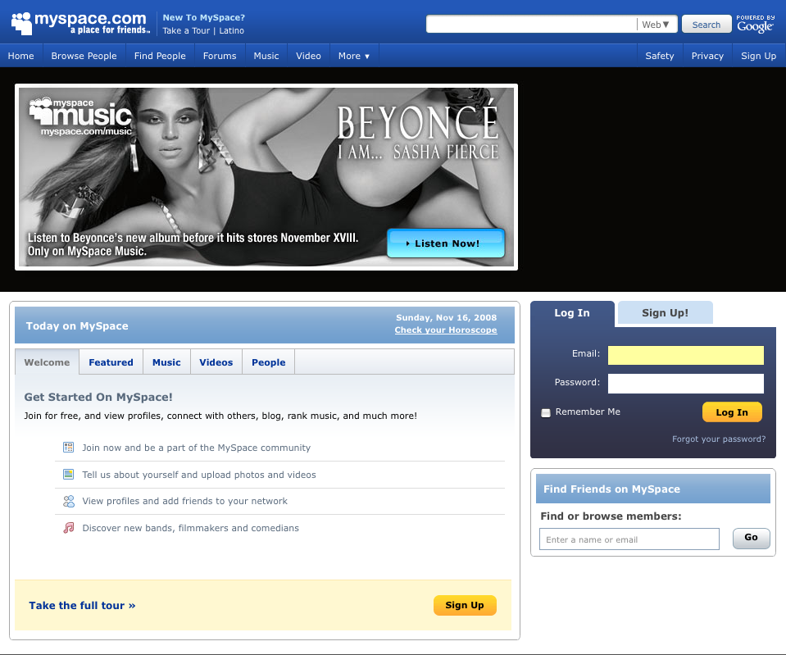

Slide 8
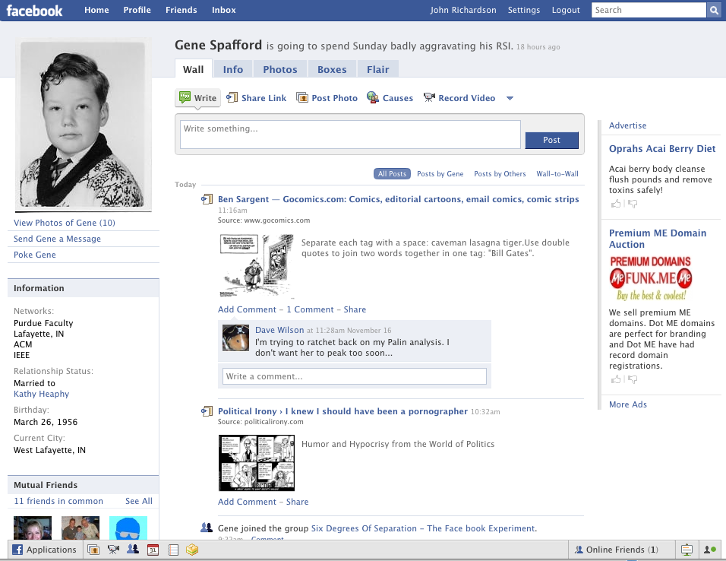
Notes:
Name, date of birth, age, state,
Depression, lack of positive self-image, self-esteem..

Slide 9
Video – The Lure of social networking
Notes:
Video is 7:07
http://www.youtube.com/watch?v=g6YT6sEDZiE

Slide 10
Key Risks for Kids
Cyber stalking
Kid’s assume what they see online is true – including claims that a buddy is their age
Cyber bullying
Slam sites
Plagiarism
Cell phone camera
Too much screen time
What's true & what's not - checking authenticity

Slide 11
Video – If you wouldn’t say it in person, don’t say it online
Notes:
http://www.youtube.com/watch?v=seOQyMvG99w&feature=user
Video is 50 seconds long

Slide 12
Technology in the Classroom
Abuse
Practical Use

Slide 13
Cheating
All the old ways still work, but…
Technology offers new ways to hide data
Simple hybrids
Paper inside battery compartment
Using technology as designed
On the internet during class
Stored notes on phone, iPod, calculator
TXT messaging for help
TXT messages to the next class about the test
Videos on YouTube offer help with cheating…

Slide 14
Notes:
Video is 1:37. Made from videos from YouTube –
http://www.youtube.com/watch?v=r9uCFuC0gHo&feature=related – how to cheat on a test final, and
http://www.youtube.com/watch?v=91lQK5SCzlQ&feature=related – how to cheat on any test

Slide 15
Practical Use
Dealing with a protected network
General strategy – preload pages & videos
Bringing in YouTube Video clips
http://www.methodshop.com/gadgets/tutorials/youtuberip/index.shtml
Tool to grab FLV file (DownloadHelper)
Tool to convert FLV to WMV or QuickTime (QuickTime Pro)
May need a plug-in to handle FLV (Perian)
Tools exist for private surfing – can also get past filters in some cases
Tor (torproject.org), FreeGate, Ultrasurf

Slide 16
Research
Information Sources
Quality of Information
Dealing with Plagiarism

Slide 17
Research
Quiz: What’s the first place kids turn to?
Google
Is Wikipedia unreliable?
Constant review & updates differentiate it from print media
Jimmy Wales' Wikipedia comes close to Britannica in terms of the accuracy of its science entries, a Nature investigation finds. – Nature, December 2005, updated March 2006

Slide 18
Quality of Sources Online
Use and teach techniques for critical examination
Lots of good material on this
For example, aspects of web evaluation included
Authorship , Perspectives, Publishing Body/Publisher, Coverage, Currency, Accuracy or Verifiability
I started here:
http://new.vawnet.org/category/index_pages.php?category_id=761

Slide 19
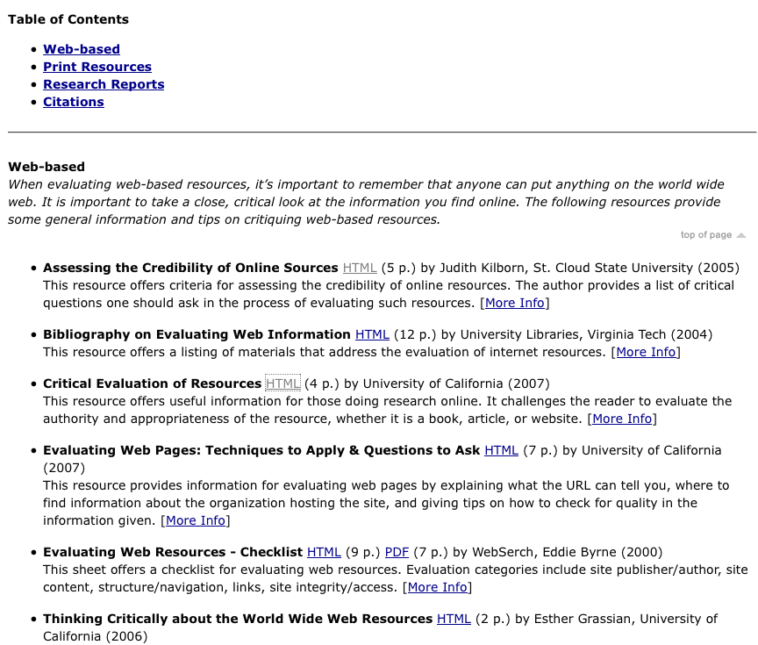

Slide 20
Plagiarism - Resources
Plagiarism.org – good resource on how to explain, standards to hold kids to, videos, pointers to detection tools
Detection
Google – - (of course) limited to 32 word search and you need to identify unique passages
connexus.com – EVE2 - $20 purchase of software tool you can use over and over
turnitin.com – expensive, used by colleges
ithenticate.com – medium expense, used by colleges & corporations

Slide 21
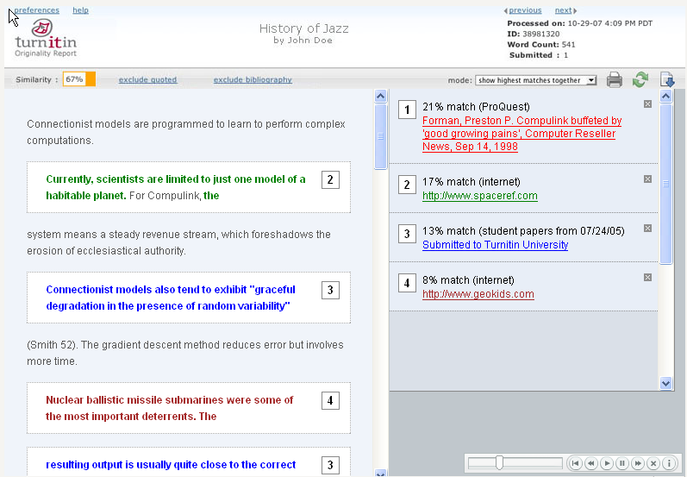

Slide 22
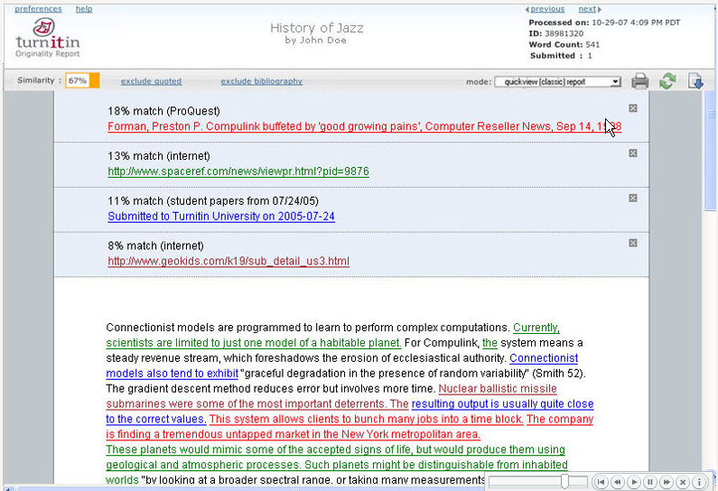

Slide 23
How might we guide researchers?
Effective use of searching techniques
Specific keywords
Mandatory marker ‘+’
Advanced features like eliminating undesired overlaps
Critical thinking / skeptical eye
Using (and keeping track of) multiple sources
Evaluating quality of sources
Proper citations
Clear coverage of plagiarism
Including appropriate policies

Slide 24
Potential Discussion Topics
What is the role of the school in…
Cyber Safety
Teaching Research Skills
Addressing Plagiarism
Taking Advantage of Technology – fairly

Slide 25
Handouts for Parents
Contact Information
John Richardson
Security and Privacy Consultant
Lumination, LLC
jr@LuminationLLC.com

Slide 26
Technology Policy Suggestions
Online ONLY in communal spaces
No connected computers, including laptops using wireless, in bedrooms
All computer use may be monitored
Limit screen time (quantity and time-of-day)
For ALL types of screens – TV, computer, IM, cell phone, games, iPod
Have rules for what must be completed before screen time
Devices downstairs at bedtime – nothing in their room
Allow Internet access only when parents are home
Only communicate (e-mail, IM, TXT) with people you already know (in real life)
Parents have a list of all accounts you use and all passwords
Discuss list of sites they are allowed to visit

Slide 27
Screen Time Checklist Suggestions
Before Screen Time…
Today’s homework is finished
Your homework & notebook is in your backpack
Your space at the table is cleaned up
You have completed today’s household chores
You are on schedule with any project you have (if no schedule, make one)
Instrument practice is complete
Your lunch box is by the sink (any trash thrown out)
Your coat is hung up
Your bed is made and clothes picked up
It is BEFORE 8:00 on school nights (8:30 on non-school nights)

Slide 28
Resources
www.NetSmartz.org, www.NetSmartzKids.org -- Resources for educators, parents, kids on how to stay safe online. Excellent presentations, videos, games, and more.
www.netlingo.com -- Large list of net acronyms, including the top 50 parents should know
www.cybertipline.com -- Run by the National Center for Missing and Exploited Children
Parents can report online abuse -- good resources.
www.SafeKids.com -- Cyber safety tips, stories, and news
www.SafetyEd.org -- General safety stuff, including car, bike, and computer
www.GetNetWise.org -- General internet safety for parents & kids
www.stopcyberbullying.org - For parents and kids on cyberbullying
www.ryanpatrickhalligan.org/cyberbullying.htm -- Father of student who committed suicide after being cyber-bullied
www.speedofcreativity.org/resources/videos-for-pd/ -- Lots of video examples to watch by yourself or with your child
www.media-awareness.ca -- Good resources, including checklists
MySpace Unraveled, Larry Magid and Anne Clooier, ISBN 0-321-48018-X
Generation MySpace, Candice Kelsey
Internet & Computer Ethics for Kids, Winn Schwartau, ISBN 0-9628700-5-6

Slide 29
Teach Your Kids Effective Decision Making Strategies
The “Golden Rule” test
How would you feel if someone did the same thing to you?
The “Mom or Dad” test
What would your Mom or Dad think?
The “Front Page” test
If your actions were reported on the front page of a newspaper what would other people think?
The “If Everybody Did It” test
What would happen if everybody made the decision to do this?
The “Check Inside” test
How do you feel inside?
Source: What is Right and What is Wrong? By Nancy Willard http://netizen.uoregon.edu

Slide 30
Top 50 Concerning Internet Acronyms Parents Need to Know:
1. 8 - it refers to oral sex
2. 1337 - it means elite
3. 143 - it means I love you
4. 182 - it means I hate you
5. 459 - it also means I love you
6. 1174 - it means nude club
7. 420 - it refers to marijuana
8. ADR or addy - Address
9. ASL - Age/Sex/Location
10. banana - it means penis
11. CD9 - it means Code 9 = parents are around
12. DUM - Do You Masturbate?
13. DUSL - Do You Scream Loud?
14. FB - F*** Buddy
15. FMLTWIA - F*** Me Like The Whore I Am
16. FOL - Fond Of Leather
17. GNOC - Get Naked On Cam (webcam)
18. GYPO - Get Your Pants Off
19. IAYM - I Am Your Master
20. IF/IB - In the Front or In the Back
21. IIT - Is It Tight?
22. ILF/MD - I Love Female/Male Dominance
23. IMEZRU - I Am Easy, Are You?
24. IWSN - I Want Sex Now
25. J/O - Jerking Off
26. KFY - Kiss For You
27. kitty - it means vagina
28. KPC - Keeping Parents Clueless
29. LMIRL - Let's Meet In Real Life
30. MOOS - Member(s) Of the Opposite Sex
31. MOSS or MOTSS - Member(s) Of The Same Sex
32. MorF - Male or Female
33. MOS - Mom Over Shoulder
34. MPFB - My Personal F*** Buddy
35. NALOPKT - Not A Lot Of People Know That
36. NIFOC - Nude In Front Of Computer
37. NMU - Not Much, You?
38. P911 - Parent Alert
39. PAL - Parents Are Listening
40. PAW - Parents Are Watching
41. PIR - Parent In Room
42. POS - Parent Over Shoulder
43. PRON – Porn
44. Q2C - Quick To Cum
45. RU/18 - Are You Over 18?
46. RUH - Are You Horny?
47. S2R - Send To Recieve (pictures)
48. SorG - Straight or Gay
49. TDTM - Talk Dirty To Me
50. WYCM - Will You Call Me?
For Mature Audiences

Slide 31
Suggestions for Responsible Use of a Windows System
Do regular backups
Use USB disks, writable DVDs, thumb drives, online, and/or other computers in your house – photos especially
Anti-virus (MOST IMPORTANT)
Have a subscription to get regular updates
Have auto-update turned on
Do weekly full-system scans (3AM is a good time)
Firewall
Use Windows firewall (enable in control panel) – or the firewall from your AV
Microsoft Update
Does all Windows update does, but includes MS Office
Set to automatically update the system
Run it manually every month or so and select “Custom” and get non-critical updates
Anti-spyware, phishing, etc.
Most AV tools have all these features – spyware is important, phishing, spam, their backup less so
Consider using “Spybot search and destroy” periodically (www.safer-networking.org)
Keep other software up to date
Adobe Reader, Flash, and Shockware (www.adobe.com)
Java (sun.com)
Clean out your temp files and defragment your disk every 6 months
Consider parental control software
You are looking to keep logs, limit sites, set time limits (quantity and time-of-day)
Source: John Richardson, on the shoulders of many others

Slide 32
What to do when…
Somebody stumbles on inappropriate material
Get out of it (if possible)
Tell your parents / advisor
Check for virus
You feel uncomfortable
Get offline
Tell your parents / advisor
Make sure you’ve followed safe computing
Parents – save session info…
You get a virus / spyware
Reboot – some are just memory resident
Run anti-virus / anti-spyware scan
If it doesn’t go away, get help!
Source: John Richardson, on the shoulders of many others

Slide 33
How Parents Help Keep Kids Safe
Educate yourself about digital technologies!
Use prudence in you own online behaviors (including blogging)
Basic responsible computing
Policies for kids in the home
Walk through cyberspace with your child
Discuss ahead of time
Tools

Slide 34
Responsible Computing
Tools & Maintenance
Anti-virus
Firewall
Up-to-date software
Operating system, Java, Adobe, Office tools
Subscriptions
Tiered email accounts
Netiquette
Don't send a message when you're angry -- write but don't send if you must.
Don't forward nasty messages
Only forward with permission
Address list minimization
Don't fall into group mentality about nasty online sites
Reply-all

Slide 35
Considering Time and Balance
How it is
The average child is watching about 3 hours of TV per day¹
The average kid spends 5½ hours on all media combined²
An estimated 17 percent of kids 2-19 years are overweight³
Recommendations
Screen time should be limited to no more than 1 to 2 hours of quality programming a day for children 2 years and older.¹
School-age children should have a minimum of one hour of physical activity per day⁴
School-age children should not be inactive for periods longer than 2 hours⁴
Sources: ¹ American Academy of Pediatrics
² Kaiser Family Foundation
³ 2003-2004 National Health and Nutrition Examination Survey (NHANES)
⁴ National Association for Sport and Physical Education (NASPE)

Slide 36
Take A Walk Through Cyberspace – With Your Child
Pull up a chair next to your child at the computer and ask them to…
Share with me all the programs and sites you use for gaming, IM and social networking sites
Share with me all the screen names and email accounts you use and passwords (example)
Show me your personal website, and any profiles you have on social networking sites, as well as your “away” message
Share with me your buddy list – ensure you know IRL
Ask if they’ve shared their password with a friend
Define cyber-bullying and discuss (& show video)
Check for naivety, “the digital wake”, sharing information, reputation, and “netiquette”
Create a safe respectable online personality
Establish trust-but-verify policy
Consider appropriate technology for their age
Adapted from http://www.ryanpatrickhalligan.org/cyberbullying.htm

Slide 37
Discuss Ahead of Time
Discuss your family values and how they apply
Great tool – empathy – how would you feel if…
Support system
Keep lines of communication open
Trust but verify
Who do they turn to if something happens?
How will you support them?
What do Kids Need to Know?
What information not to share / how to not share it
What can happen to them
What do you do when you find something that makes you uncomfortable?
Kids going to inappropriate sites
Kids interacting with people you don't know or don't approve of
Kids arranging to meet somebody they met in cyberspace

